Slide 1
Case 1: a primary from a single reflector (recorded data)
Reflector

Slide 2
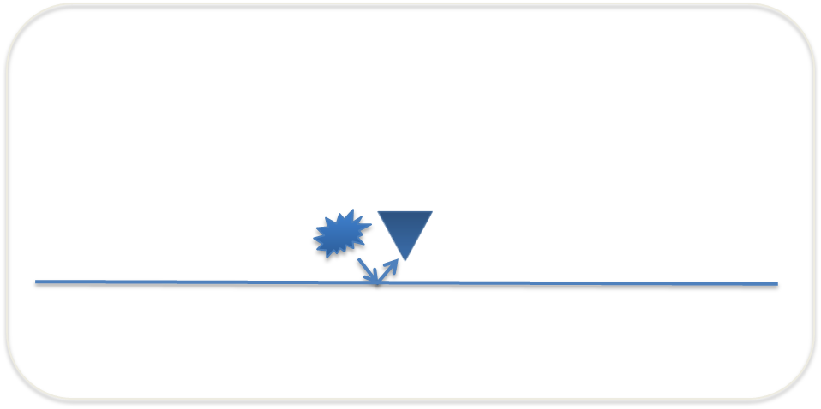
Case 1: a primary from a single reflector
Above the reflector (predicted experiment at depth)
Coincident source and receiver at depth for all times
Coincident source and receiver at depth for t = 0
Blue event: primary
Blue event: primary

Slide 3
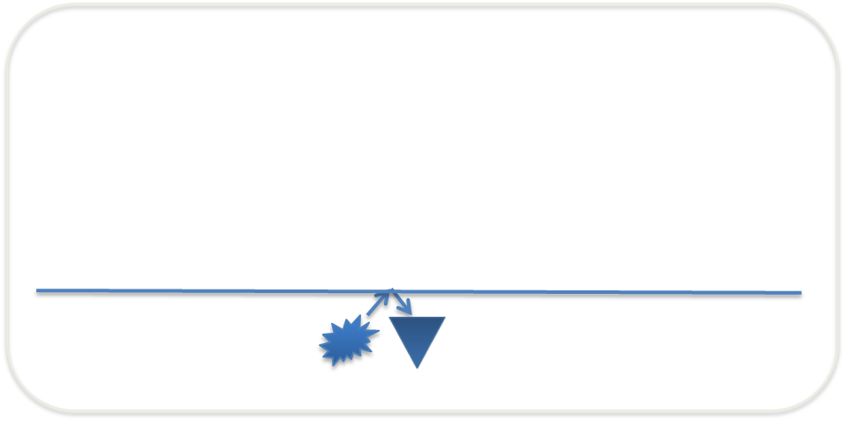
Case 1: a primary from a single reflector
Below the reflector (predicted experiment at depth)
Coincident source and receiver at depth for all times
Coincident source and receiver at depth for t = 0
Blue event: primary
Blue event: primary

Slide 4
Case 2: a primary and a free-surface multiple (recorded data)
Free surface
Reflector
Red event: primary
Blue event: free-surface multiple

Slide 5
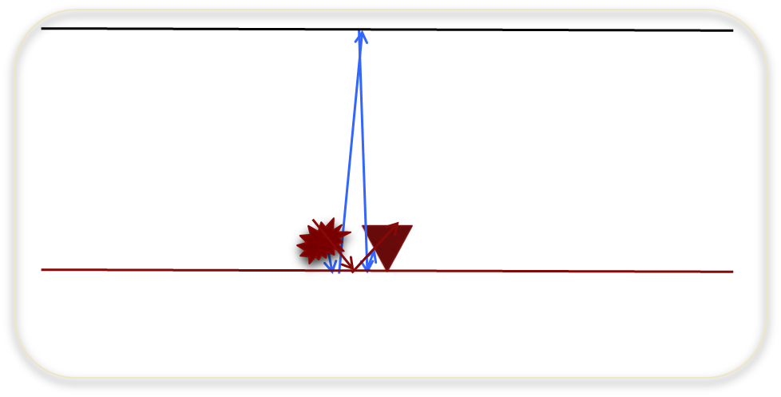
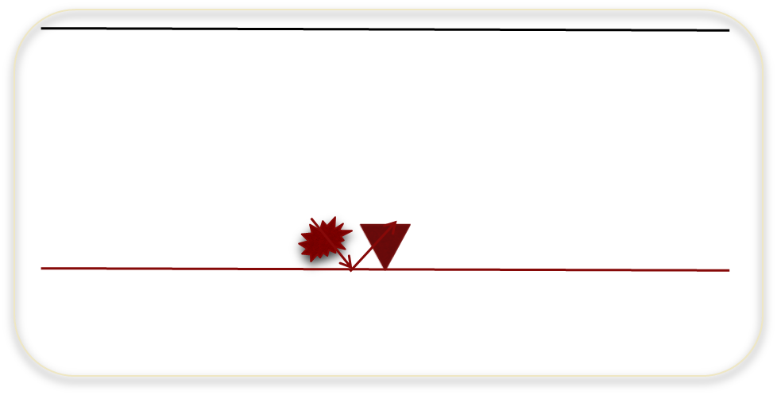
Case 2: a primary and a free-surface multiple
Above the reflector (predicted experiment at depth)
Coincident source and receiver at depth for all times
Coincident source and receiver at depth for t = 0
Red event: primary
Blue event: free-surface multiple
Red event: primary

Slide 6
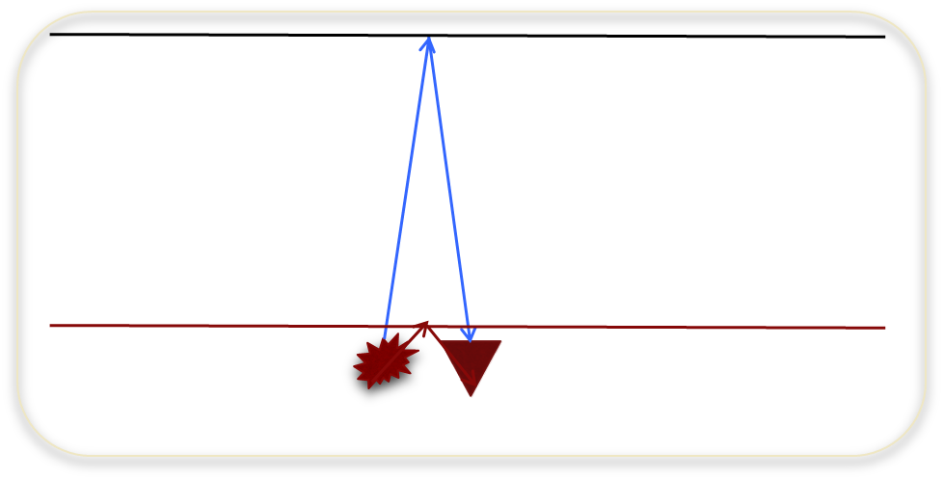
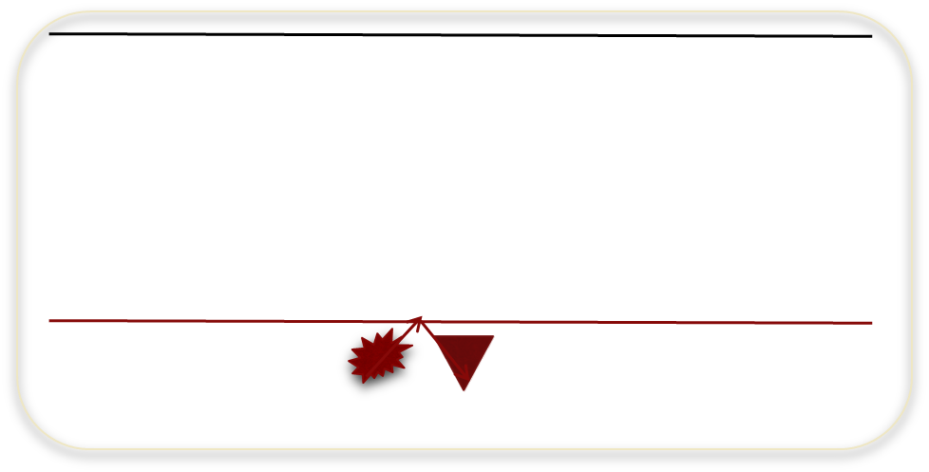
Case 2: a primary and a free-surface multiple
Below the reflector (predicted experiment at depth)
Coincident source and receiver at depth for all times
Coincident source and receiver at depth for t = 0
Red event: primary (downward reflection at the reflector)
Blue event: primary (downward reflection at the free surface)
Red event: primary (downward reflection at the reflector)

Slide 7
Case 3: two primaries and an internal multiple
(recorded data)
Reflector 1
Reflector 2
Red event: primary from the first reflector
Black event: primary from the second reflector
Blue event: internal multiple

Slide 8
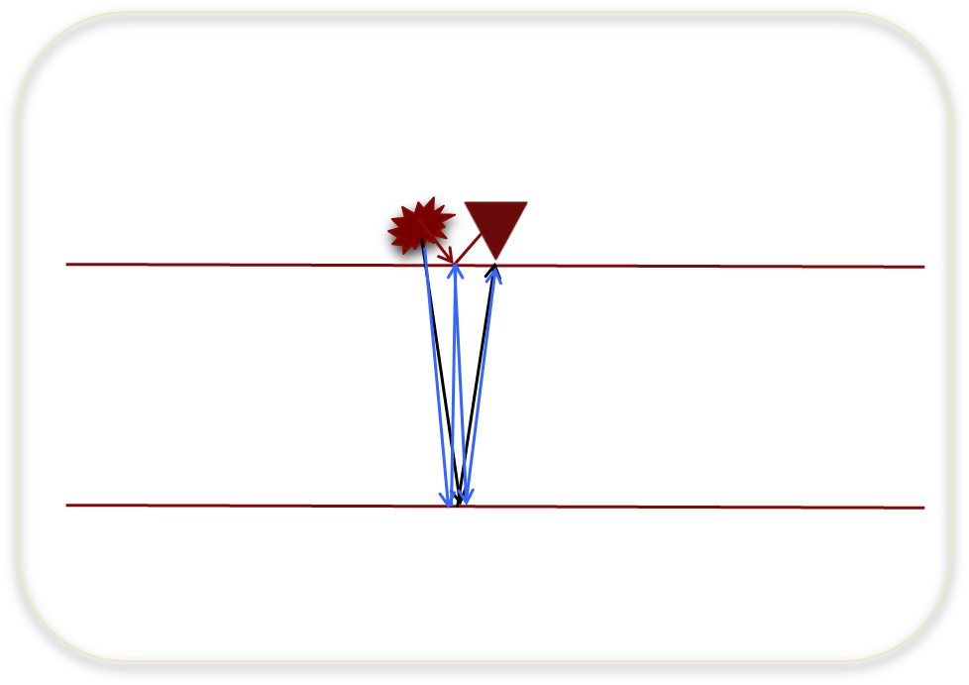
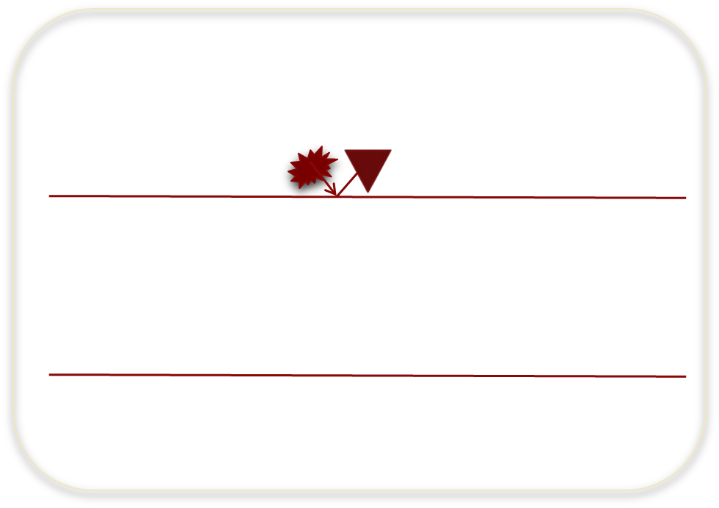
Case 3: two primaries and an internal multiple
Above the first reflector (predicted experiment at depth)
Coincident source and receiver at depth for all times
Coincident source and receiver at depth for t = 0
Red event: primary from the first reflector
Black event: primary from the second reflector
Blue event: internal multiple
Red event: primary from the first reflector

Slide 9
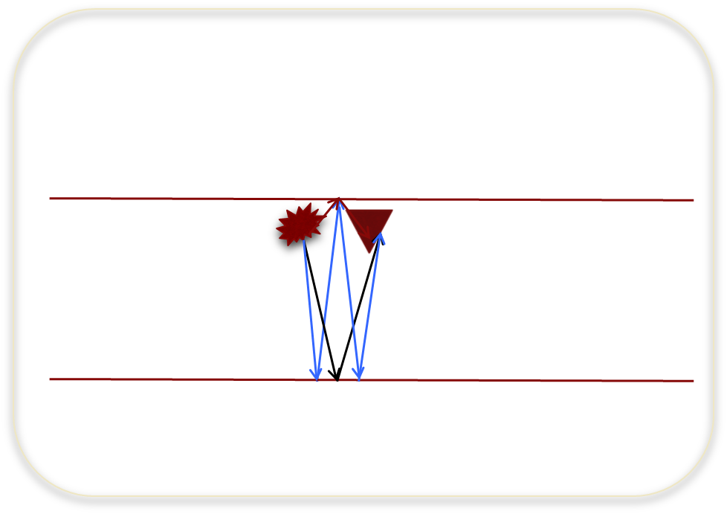
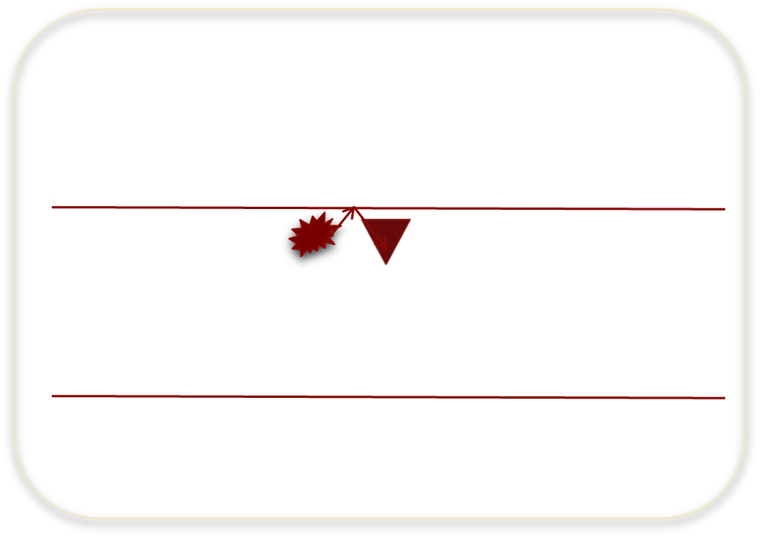
Case 3: two primaries and an internal multiple
Below the first reflector (predicted experiment at depth)
Coincident source and receiver at depth for all times
Coincident source and receiver at depth for t = 0
Red event: primary from the first reflector
Black event: primary from the second reflector
Blue event: internal multiple
Red event: primary from the first reflector

Slide 10
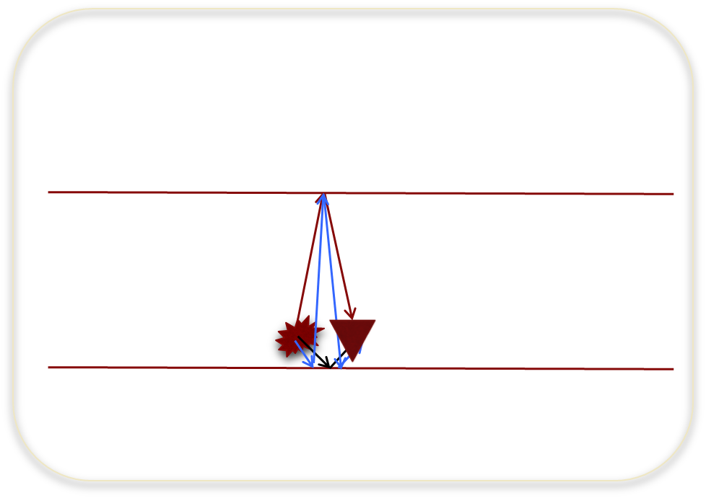
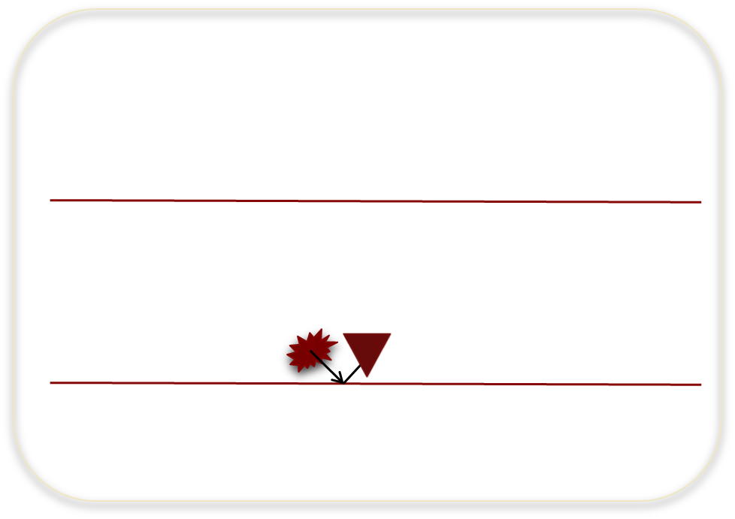
Case 3: two primaries and an internal multiple
Above the second reflector (predicted experiment at depth)
Coincident source and receiver at depth for all times
Coincident source and receiver at depth for t = 0
Red event: primary from the first reflector
Black event: primary from the second reflector
Blue event: internal multiple
Black event: primary from the second reflector

Slide 11
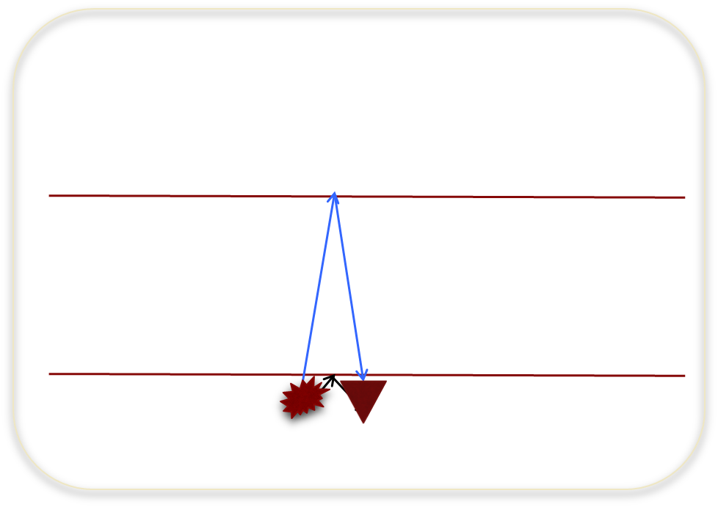
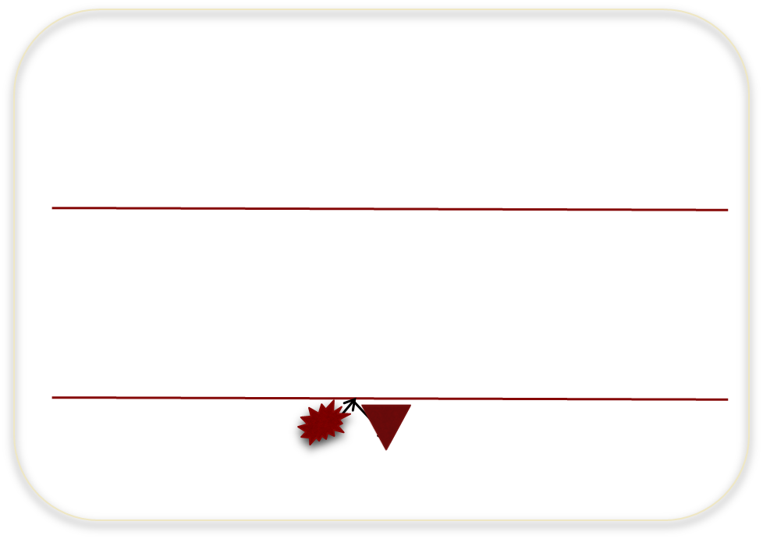
Case 3: two primaries and an internal multiple
Below the second reflector (predicted experiment at depth)
Coincident source and receiver at depth for all times
Coincident source and receiver at depth for t = 0
Blue event: primary from the first reflector
Black event: primary from the second reflector
Black event: primary from the second reflector

